Slide 1
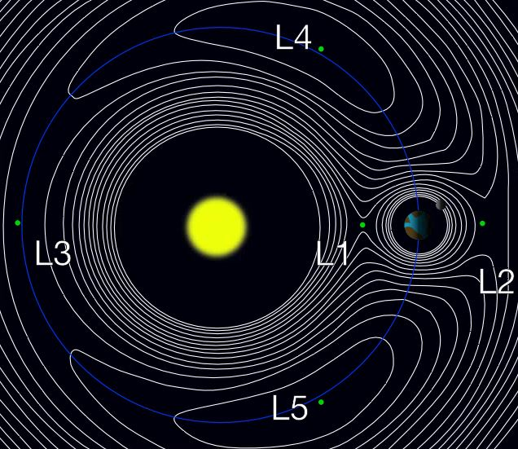
L5 in Tandem with L1
The Challenges of 24/7/364 Day Operations
A Spacecraft Operator’s View
Ewan Haggarty SKYNET SMA
6 Mar 2017

Slide 2
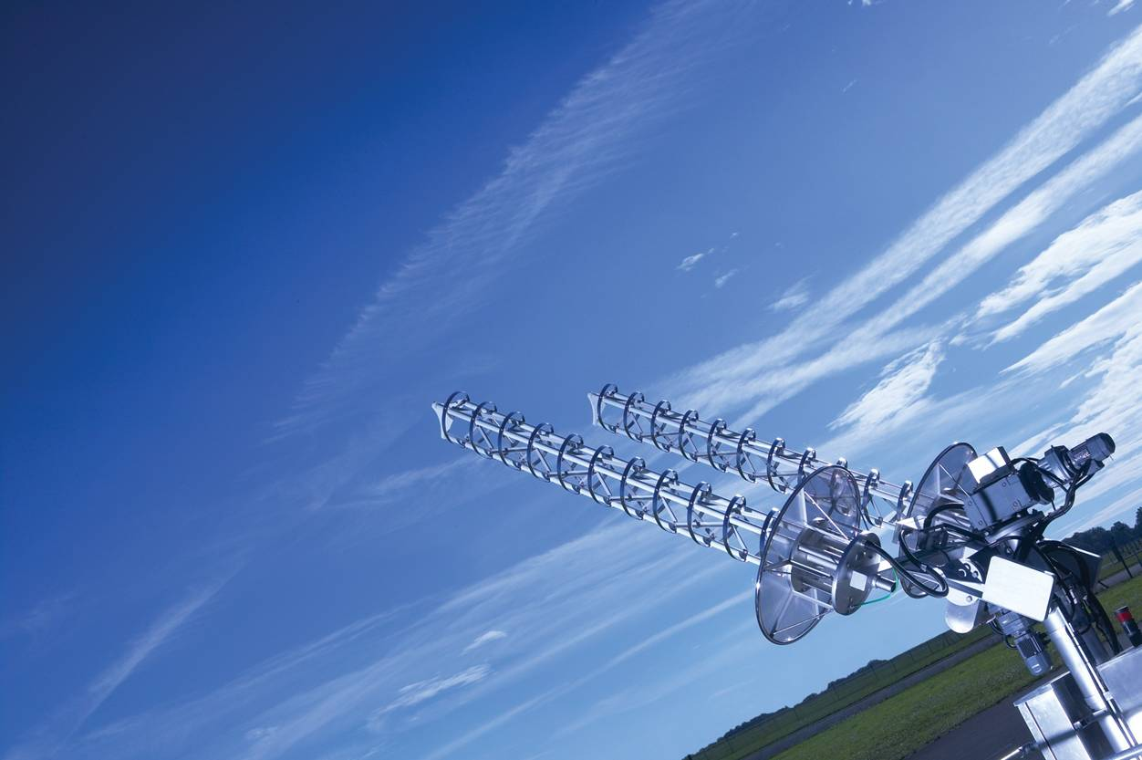
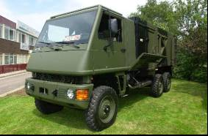
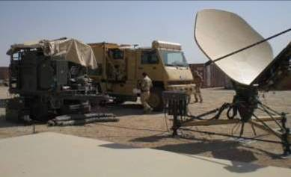
Airbus Defence and Space, CIS, SATCOM, UK Government
Airbus D&S provides end-to-end, resilient secure communications services to UK Government and other third party international government organisations

Slide 3
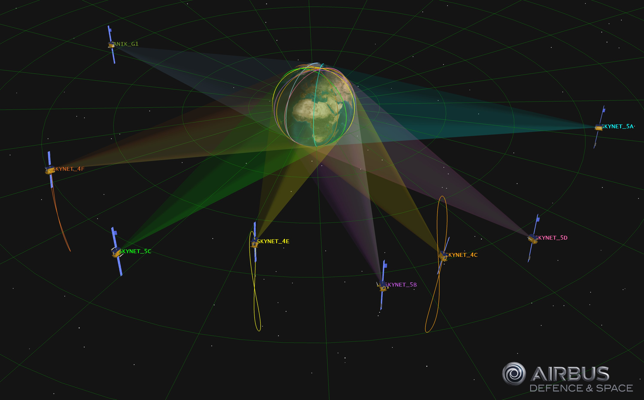

Slide 4
SKYNET Constellation Overview
SKYNET 4 Spacecraft:
All over 20 years in Operation – Design Life of 8 years
Many different anomalies overcome, retaining diversity/ redundancy in all key systems through in-flight analysis and engineering
SKYNET 5 Spacecraft:
Youngest (5A) about to turn 10 years old
Spacecraft bus is an E3000 – the 4 in our Constellation are members of a group of some 60 others of similar type
SKYNET Ground Segment
Supports Mission Operations 365/7/24 with continuous TT&C from all Spacecraft, using Heads mostly Dual Purposed for carrying X-Band Communications.
Recently expanded with a new-build SGS in Adelaide for SKYNET 5A.
Our Reliability Specification Target is 99.998% = 10 mins/year of unplanned downtime

Slide 5
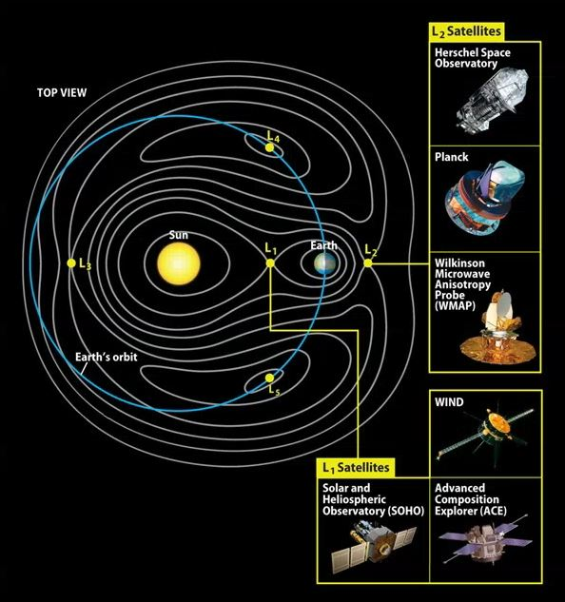
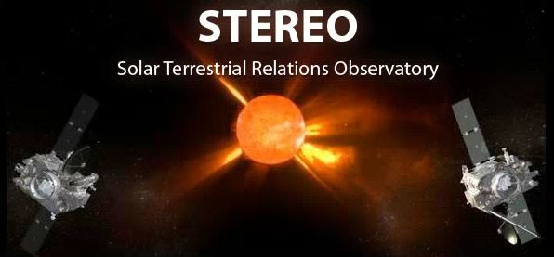
A Brief Review of Previous Missions
Experience has been developed in the mission operation away from Earth orbit and for the observing the Universe, Sun and Sun-Earth environment. These include:
Hershel
Planck – at L2
WMAP
WIND
SOHO – at L1
ACE
STEREO – earth-orbit like
Some indication of Profile and Objective Differences between these Science Missions and an Operational L5 and L1 Tandem SpaceWx mission can be made.

Slide 6
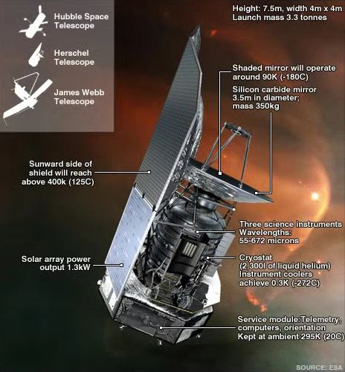
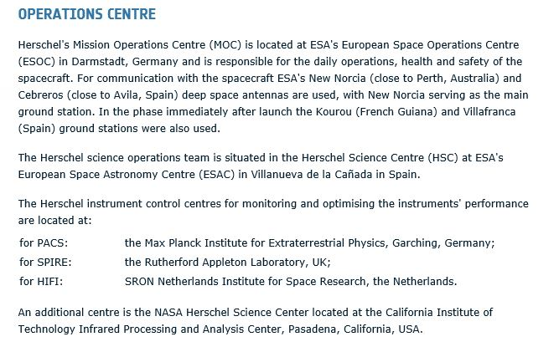
Herschel
Infrared Telescope, EOM 2013
One Prime, 1 Backup SGS – no continuous downlink.
http://sci.esa.int/herschel/47356-fact-sheet/

Slide 7
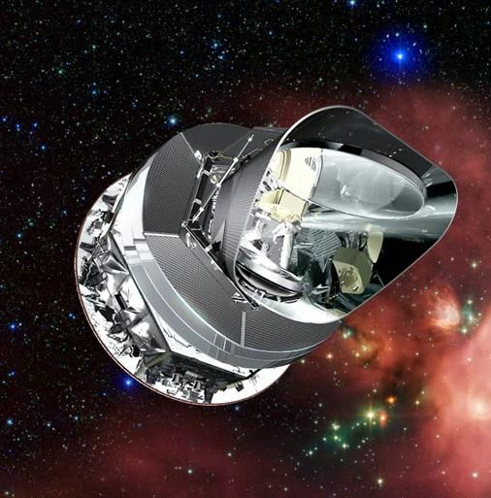
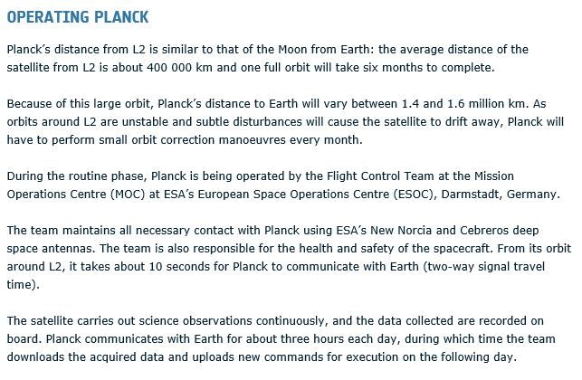
Planck
Cosmic Microwave Background Observatory, EOM 2013
One Prime, 1 Backup SGS – no continuous downlink.
http://www.esa.int/Our_Activities/Space_Science/Planck/Operating_Planck

Slide 8
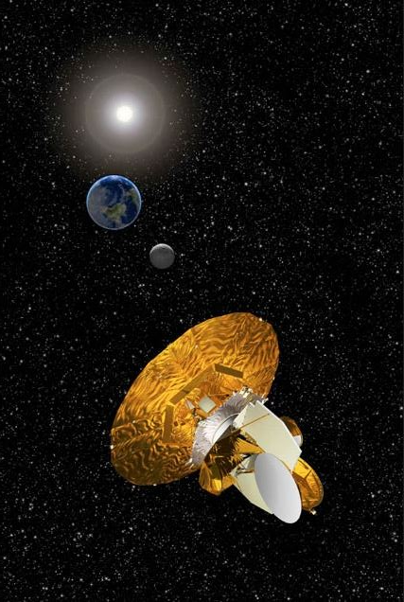
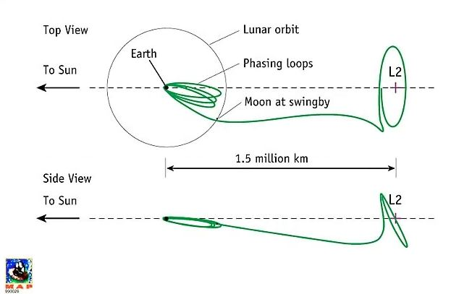
WMAP
Wilkinson Microwave Anisotropy Probe, EOM 2010
Once in orbit about L2, the satellite maintains a Lissajous orbit such that the WMAP-Earth vector remains between 1 and 10 degrees off the Sun-Earth vector to satisfy communications requirements while avoiding eclipses. Station-keeping maneuvers are required about 4 times per year to maintain the orbit.
Used NASA Deep Space Network – no continuous downlink.
https://map.gsfc.nasa.gov/mission/observatory_orbit.html

Slide 9
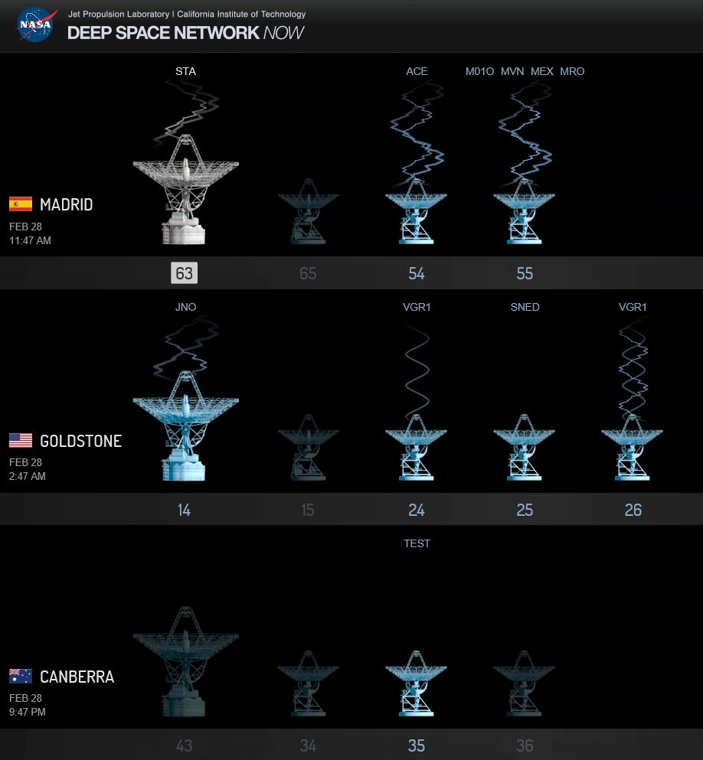
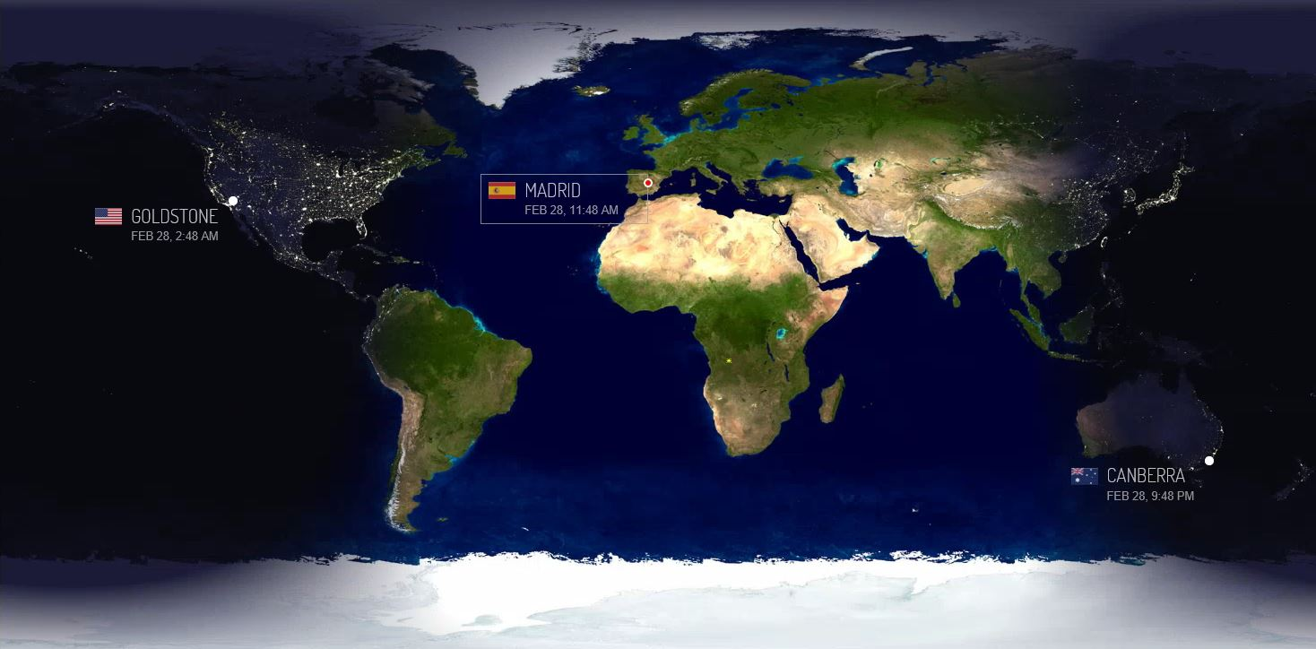
NASA Deep Space Network
Supports Multiple Missions from 3 near-ideally located sites
Each DSN site has multiple large antennas and is designed to enable continuous radio communication between several spacecraft and Earth. All three complexes consist of at least four antenna stations. Antenna stations are remotely operated from a signal processing center at each complex. The centers house electronic systems that point and control the antennas, receive and process data, transmit commands and generate spacecraft navigation data. Once the data is processed at the complexes, it is transmitted to NASA's Jet Propulsion Laboratory for further processing and distribution to science teams over a ground communications network.
NASA Deep Space Network – 13 Antennas in all
https://deepspace.jpl.nasa.gov/dsnnow/

Slide 10
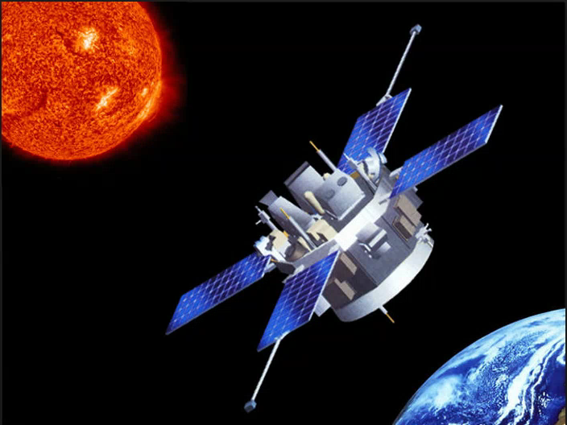
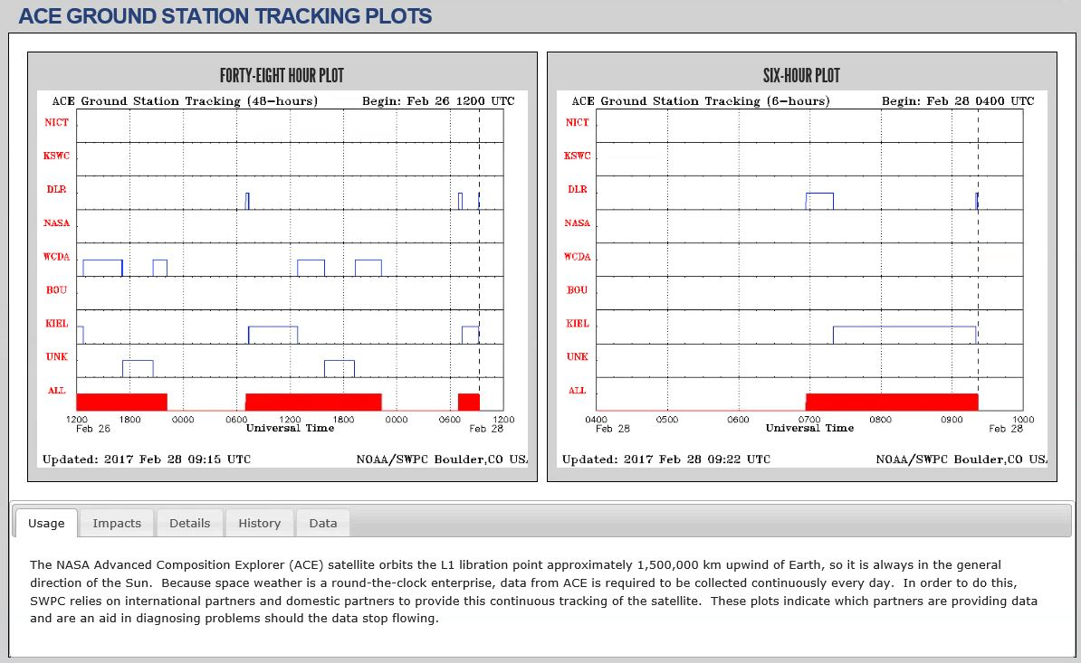
ACE
Advanced Composition Explorer, Operational
Multiple SGS – no continuous downlink.
http://www.srl.caltech.edu/ACE/
The RTSWnet consists of:
•National Institute of Information and Communications Technology (NICT) in Tokyo, Japan
•Korean Space Weather Center (KSWC) in Jeju, Korea
•German Aerospace Center (DLR) in Neustrelitz, Germany
•Station DL0SHF in Kiel-Roenne, Germany
•NASA Deep Space Network (NASA)
•NOAA Wallops Command and Data Acquisition (WCDA) Station in Wallops Island, Virginia
•NOAA Space Weather Prediction Center (BOU) in Boulder, Colorado
•UNK (unknown) indicates a new, as yet unassociated tracking station identifier. New identifiers are usually assigned within a few days.

Slide 11
Key Challenges
24/7/365 Day Operations

Slide 12
SGS Locations
Assumptions:
L5 & L1 Tandem Mission
Assured Continuous Data Downlink from Both Satellites
This type of Ground Segment Capability for Non-Geo Orbits has not been previously demonstrated
May well have more challenges than revealed through top-level analysis
Minimum Requirement:
3 (+?) DSN – like globally distributed sites
Each of the 3 Sites, for Each Mission, has:
A Prime and Backup Antenna
Separated Power Supplies with UPS
Protected separate Prime and Backup data links from site to control and data analysis centres
Shopping List
12 Dedicated Antennas – The risk of Primary failure during rotational maintenance precludes a Mission shared pool of 3 per site.
Separate Ducting of Data Fibre runs from SGS sites to separated Data Network Distribution nodes.
Frequency Coordination at 3 (+ ?) separate locations around the Globe
Ground Segment Resilience to Extreme SpaceWx

Slide 13
Satellite Characteristics
Minimum Requirements:
X-Band data downlink due to data rate and terrestrial weather resistance capabilities
On-board autonomy for redundancy switching of key subsystems, both Bus and Payload
Minimal intervention attitude restoration
May Be Extremely Helpful:
Shared Bus Design for L1 & L5 Missions:
One forms an ‘Engineering Model’/ baseline for the other
Commonality in Operations and Training Requirements
Representative Spacecraft Simulator
SKYNET Experience
In-Flight Engineering Data feeding a Spacecraft Operations and Anomaly Progress Group (SOAPG) is highly effective in efficiently managing a Fleet capability to a higher reliability than would be possible for a Single Spacecraft.

Slide 14
Other Considerations – A Puppy is Not Just for Xmas
People and Location of Operations:
10 Years is a long-term operational mission commitment
People need to remain interested, or:
Manning structured around an appealing Career Development path
Extreme SpaceWx effects may be regional
A geographic duplication of Control Centres and SpaceWx forecasting facilities may be required
Should Spacecraft Operational Engineers and Instrument Engineers be the Same People, or on the Same Team?
Leasing Fibre Communications between sites is a significant long-term expense
Obsolescence Management:
In SKYNET experience:
Within 10 years, 2 Major and 2 Minor Whole-Ground-System Updates have been required
One of these Major updates was required due to a change in National Government legislation
Total Cost of Ownership is very easy to underestimate whilst justified contingency preparation difficult to argue for
‘Keeping Waltzing’ whilst the ‘Floorboards of the Dancefloor’ is being renewed needs dedicated skilled staff

Slide 15
Thank you

